Slide 1


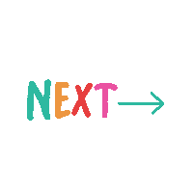
Requirement analysis for
Movie Recommendation Engine
Md Shamaun Nabi (18201050)
Md. Musfiqur Rahman (18201054)
Al Amin (18201063)
1

Slide 2

Functional Requirements
Client Application
Server Application
2

Slide 3

Client Application
The client application is the link between the user and the server application. Its task is to gather information from the users and to allow users to play movies. The information is sent to the server application, where it is stored, and later used to
produce recommendations.
3

Slide 4


Server Application
The server application receives information from the client application, and provides the client application with recommendations.
Handle recommendation requests
Store evaluations
Recommend using KNN filtering
4

Slide 5

Hardware Requirements
Pentium IV or higher, (PIV-300 GHz recommended)
256 MB RAM
1 Gb hard free drive space
5

Slide 6

Software Requirements
Database:
Kaggle, a subsidiary of Google LLC, is an online community of data scientists and machine learning practitioners. Kaggle allows users to find and publish data sets.
6

Slide 7
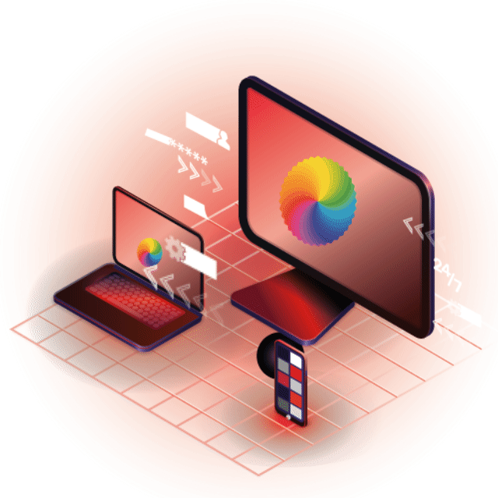
Software Requirements
Operating System:
Windows 8 or Up
7

Slide 8

Software Requirements
Front End & Back-end Technology:
Streamlit (Front-End)
Python (Back-End)
8

Slide 9

Software Requirements
IDE
Pycharm
Google Colab
9

Slide 10
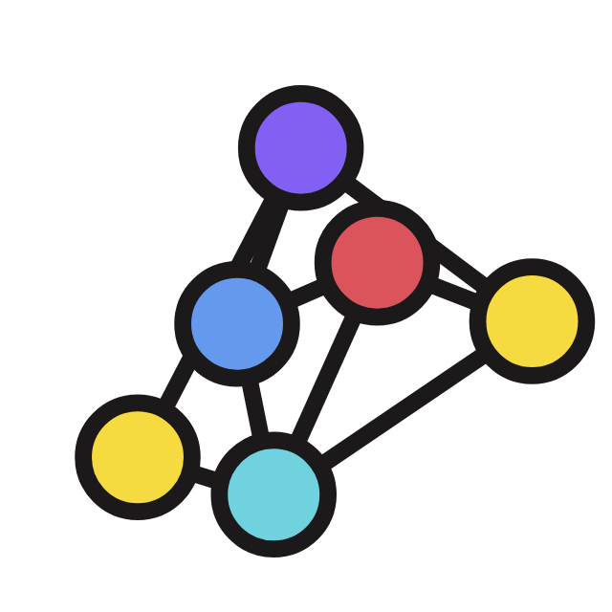
Software Requirements
Machine Learning Model
K-nearest neighbors algorithm
10

Slide 11

Design Requirements
Content based filtering
TMDV Dataset
Contains 3 columns(movie_id, title, tag).
For handling cold start
Can use genre, cast, and crew to recommend it to target users
Implementation:
Build k-nearest neighbour algorithm.
Creating Handcrafted Features : Features which represent the top five similar movies
Implement the final model
Connect with website
deployment
11

Slide 12
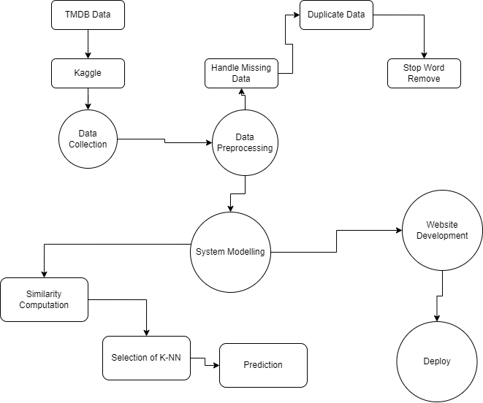
Project
Block-Diagram
12

Slide 13
13

